Slide 1
Solving the Wyrtki challenge in the Tropical Pacific Ocean State Estimate (TPOSE) 2014-2018
Ariane Verdy, Bruce Cornuelle, Matt Mazloff
Aneesh Subramanian
Scripps Institution of Oceanography
University of Colorado

Slide 2
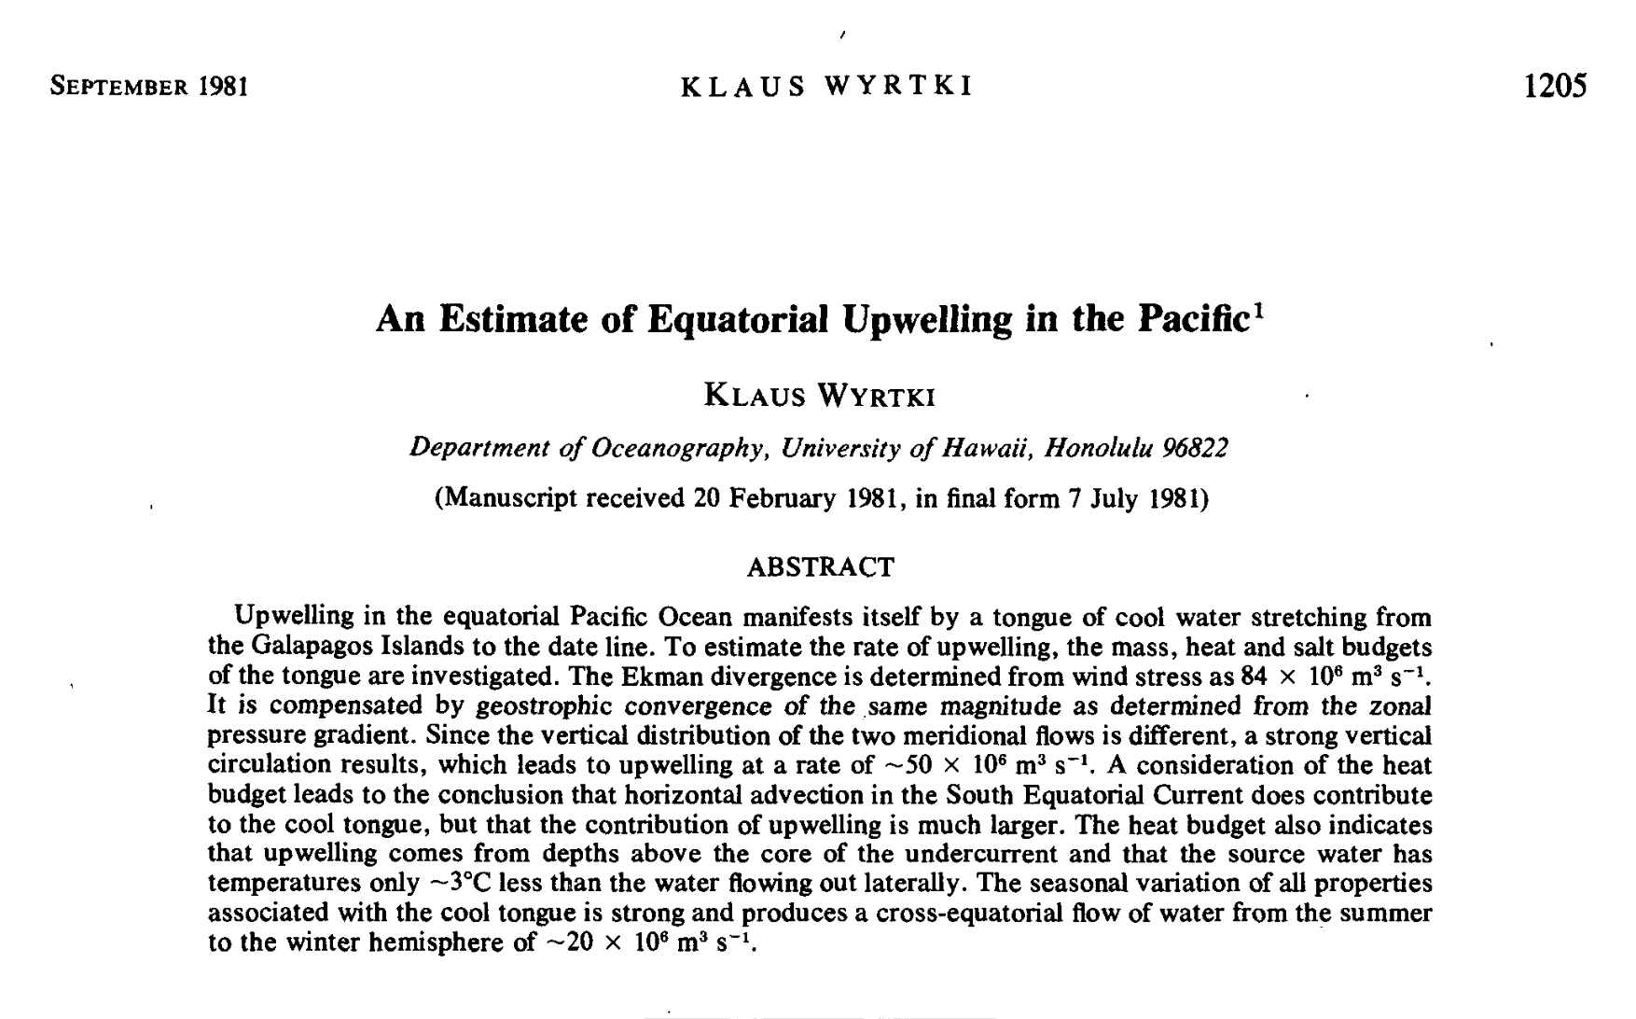

Slide 3
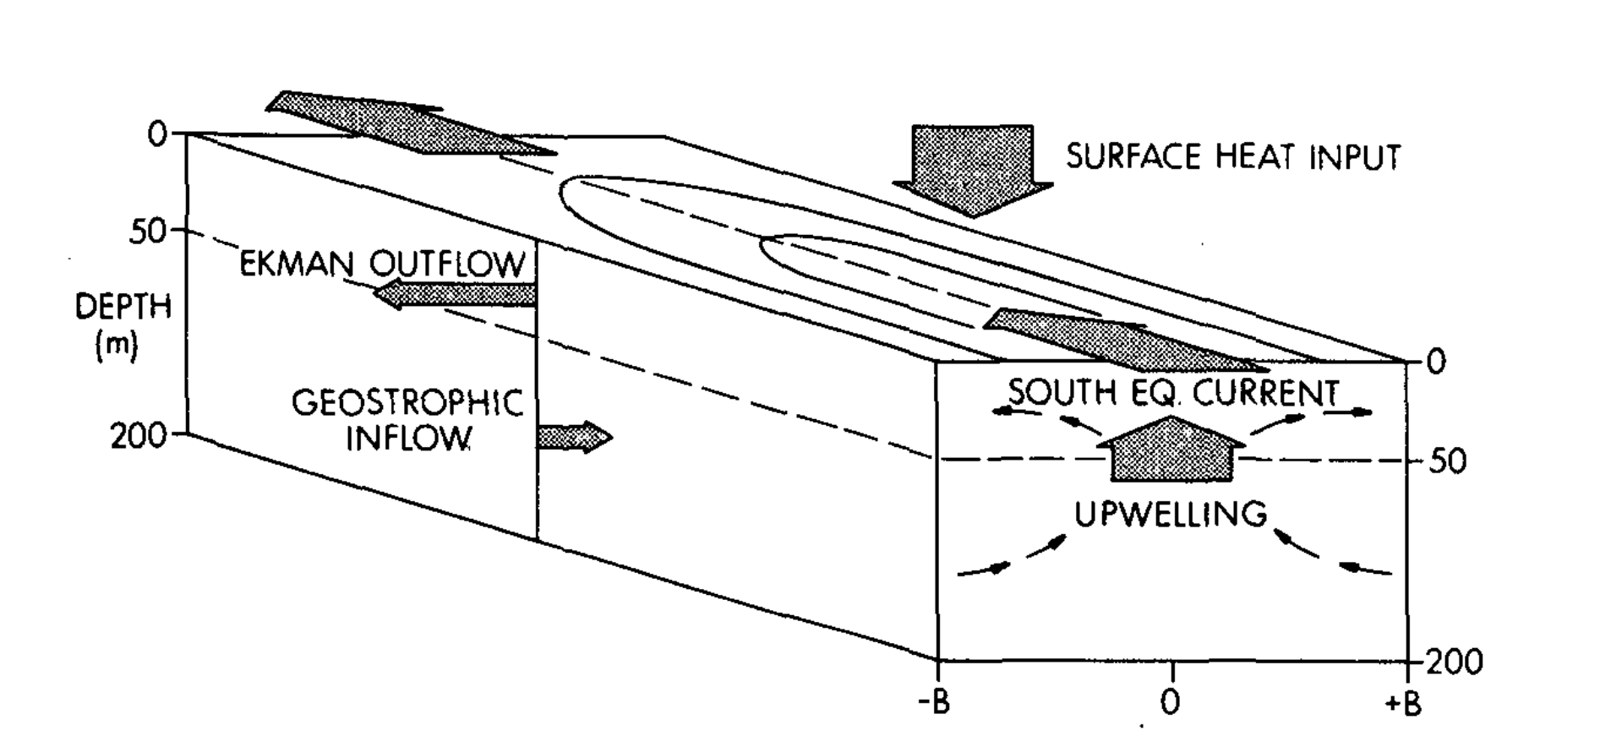
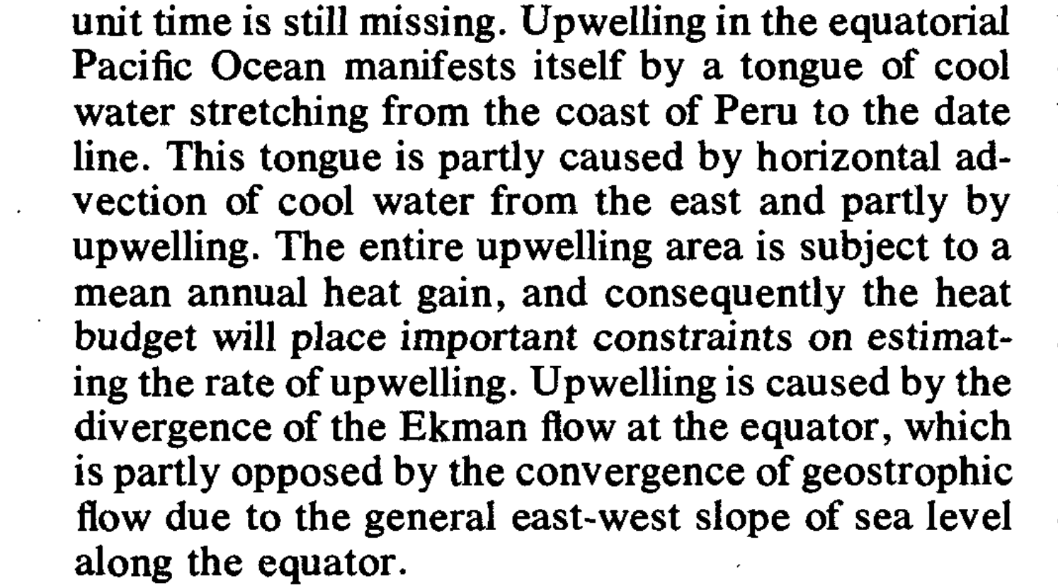

Slide 4
the problem of quantifying the contributions of upwelling, horizontal transport, and surface fluxes to mass / heat / salt budgets in the tropical Pacific
The “Wyrtki challenge”:

Slide 5
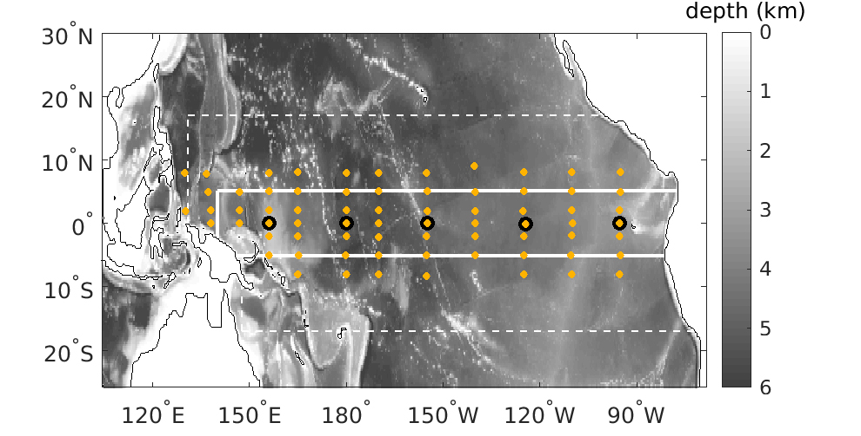
Tropical Pacific Ocean State Estimate (TPOSE) 2014-2018
Data-assimilating model – Altimetry, OI-SST, Argo, CTD, XBT
1/3 degree, 51 levels, ERA5 forcing (adjusted), IC/OBCs from HYCOM
• TAO/TRITON moorings
Verdy et al, 2017; 2023

Slide 6
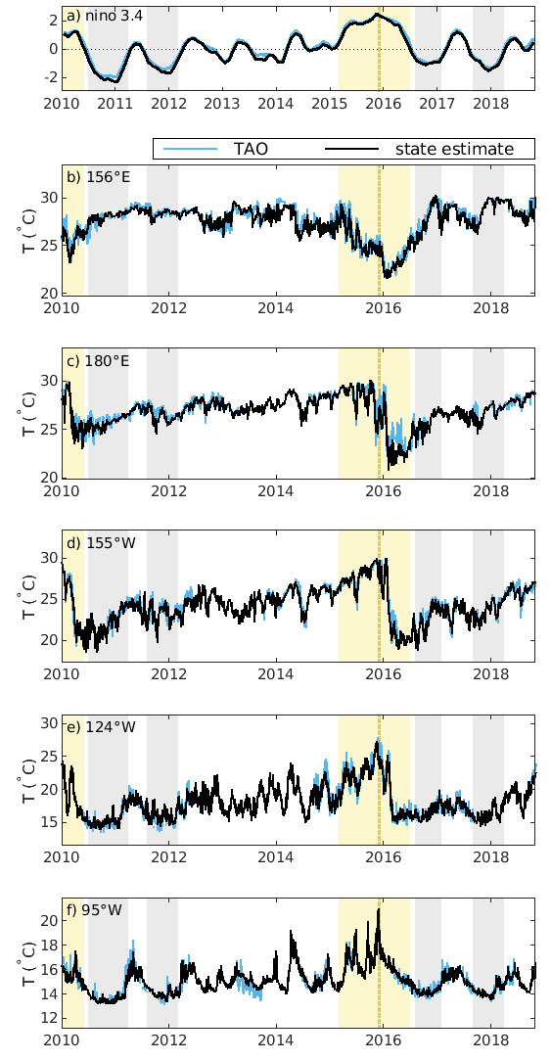
Nino 3.4 index
Model—observations comparison
156ºE
180ºE
100-m temperature
155ºW
state estimate (black)
vs
independent TAO data (blue)
124ºW
95ºW

Slide 7
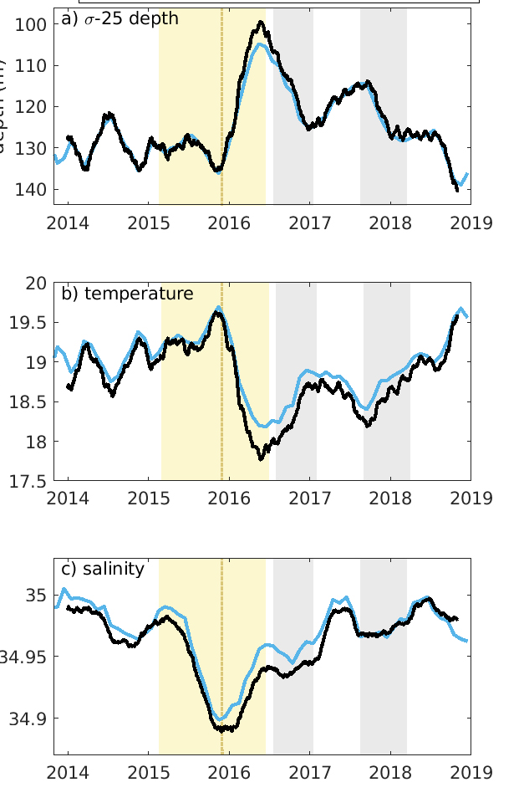
15/16 El Niño
Domain averages
(5ºS – 5ºN)
top 300 m
𝜎-25
Temp.
Salt

Slide 8
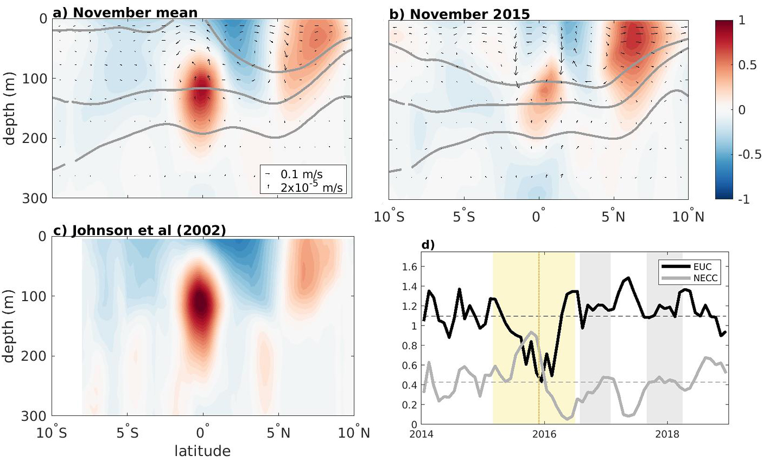
model mean
El Nino
obs
EUC
NECC

Slide 9
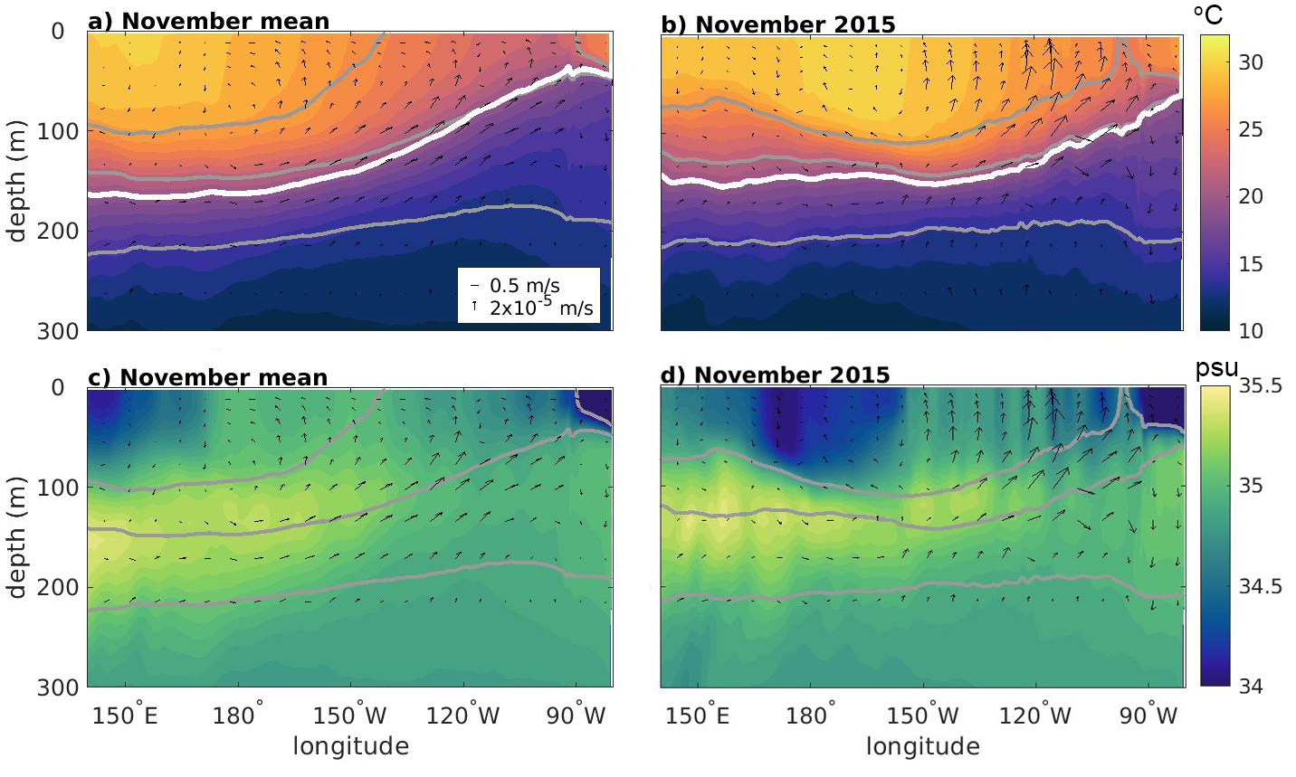
model mean
El Nino
Temp.
Salt

Slide 10
Box average budgets
up
North
East

Slide 11
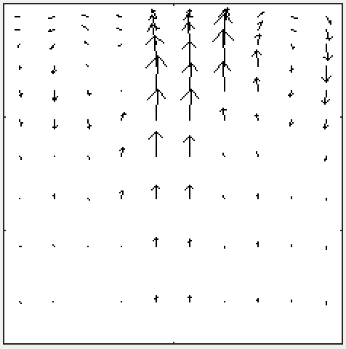
Mean volume budget
(Sv)
V_{ag 5}$°$_{N} = -32.4 $±$ 43.1
F_{surf} = 0.16$±$ 0.45
V_{g 5}$°$_{N} = 12.8 $±$ 15.9
up
North
U_{ag 140}$°$_{E} = 10.4 $±$ 11.1
East
V_{ag} ₅$°$_{S} = -47.0 $±$ 41.2
U_{g 140}$°$_{E} = -0.8 $±$ 19
V_{g 5}$°$_{S} = 49.2 $±$ 10.1
W_{300m} = 7.6 $±$ 43.1

Slide 12
Mean volume budget
Ekman
(Sv)
geostrophic
V_{ag 5}$°$_{N} = -32.4 $±$ 43.1
F_{surf} = 0.16$±$ 0.45
V_{g 5}$°$_{N} = 12.8 $±$ 15.9
up
North
U_{ag 140}$°$_{E} = 10.4 $±$ 11.1
East
V_{ag} ₅$°$_{S} = -47.0 $±$ 41.2
U_{g 140}$°$_{E} = -0.8 $±$ 19
V_{g 5}$°$_{S} = 49.2 $±$ 10.1
Ekman
geostrophic
shallow meridional overturning cell
W_{300m} = 7.6 $±$ 43.1

Slide 13
Mean temperature budget
(W/m²)
(V_{ag}T*)₅$°$_{N} = -77.0 $±$ 83
F_{surf} = 60.8 $±$ 24
(V_{g}T*)₅$°$_{N} = 52.0 $±$ 26
up
North
(U_{ag}T*)₁₄₀$°$_{E} = 9.6 $±$ 17
East
(V_{ag}T*)₅$°$_{S} = -86.5 $±$ 64
(U_{g}T*)₁₄₀$°$_{E} = -16.0 $±$ 30
(V_{g}T*)₅$°$_{S} = 72.3 $±$ 17
(WT*)_{300m} = -13.6 $±$ 77

Slide 14
Anomalous advection of heat through the
WEST, SOUTH, NORTH
Horizontal heat transport
Cumulative sum

Slide 15
WEST, SOUTH, NORTH
Cumulative sum
Geostrophic
Ageostrophic

Slide 16
$$\iiint_{V}{\frac{∂T′}{∂t}=−∇_{h}∙{\vec{v}}_{h}T^{′}−\frac{∂}{∂z}wT^{′}+mix+ \frac{Q}{ρc_{P}Δz}}$$
Heat budget
Tendency
Horiz. advection
Vertical advection
Surface forcing

Slide 17
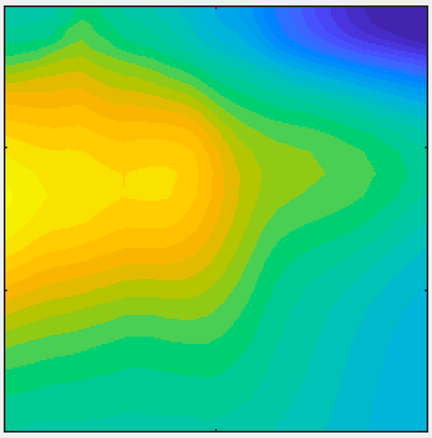
Mean salinity budget
(psu.m/yr)
F_{surf} = -10 $±$ 29
(V_{ag}S*)₅$°$_{N} = 19 $±$ 52
(V_{g}S*)₅$°$_{N} = -13 $±$ 17
up
North
(U_{ag}S*)₁₄₀$°$_{E} = 4.1 $±$ 6.5
East
(V_{ag}S*)₅$°$_{S} = -26 $±$ 30
(U_{g}S*)₁₄₀$°$_{E} = -19 $±$ 13
(V_{g}S*)₅$°$_{S} = 46 $±$ 11
(WS*)_{300m} = -2.5 $±$ 15

Slide 18
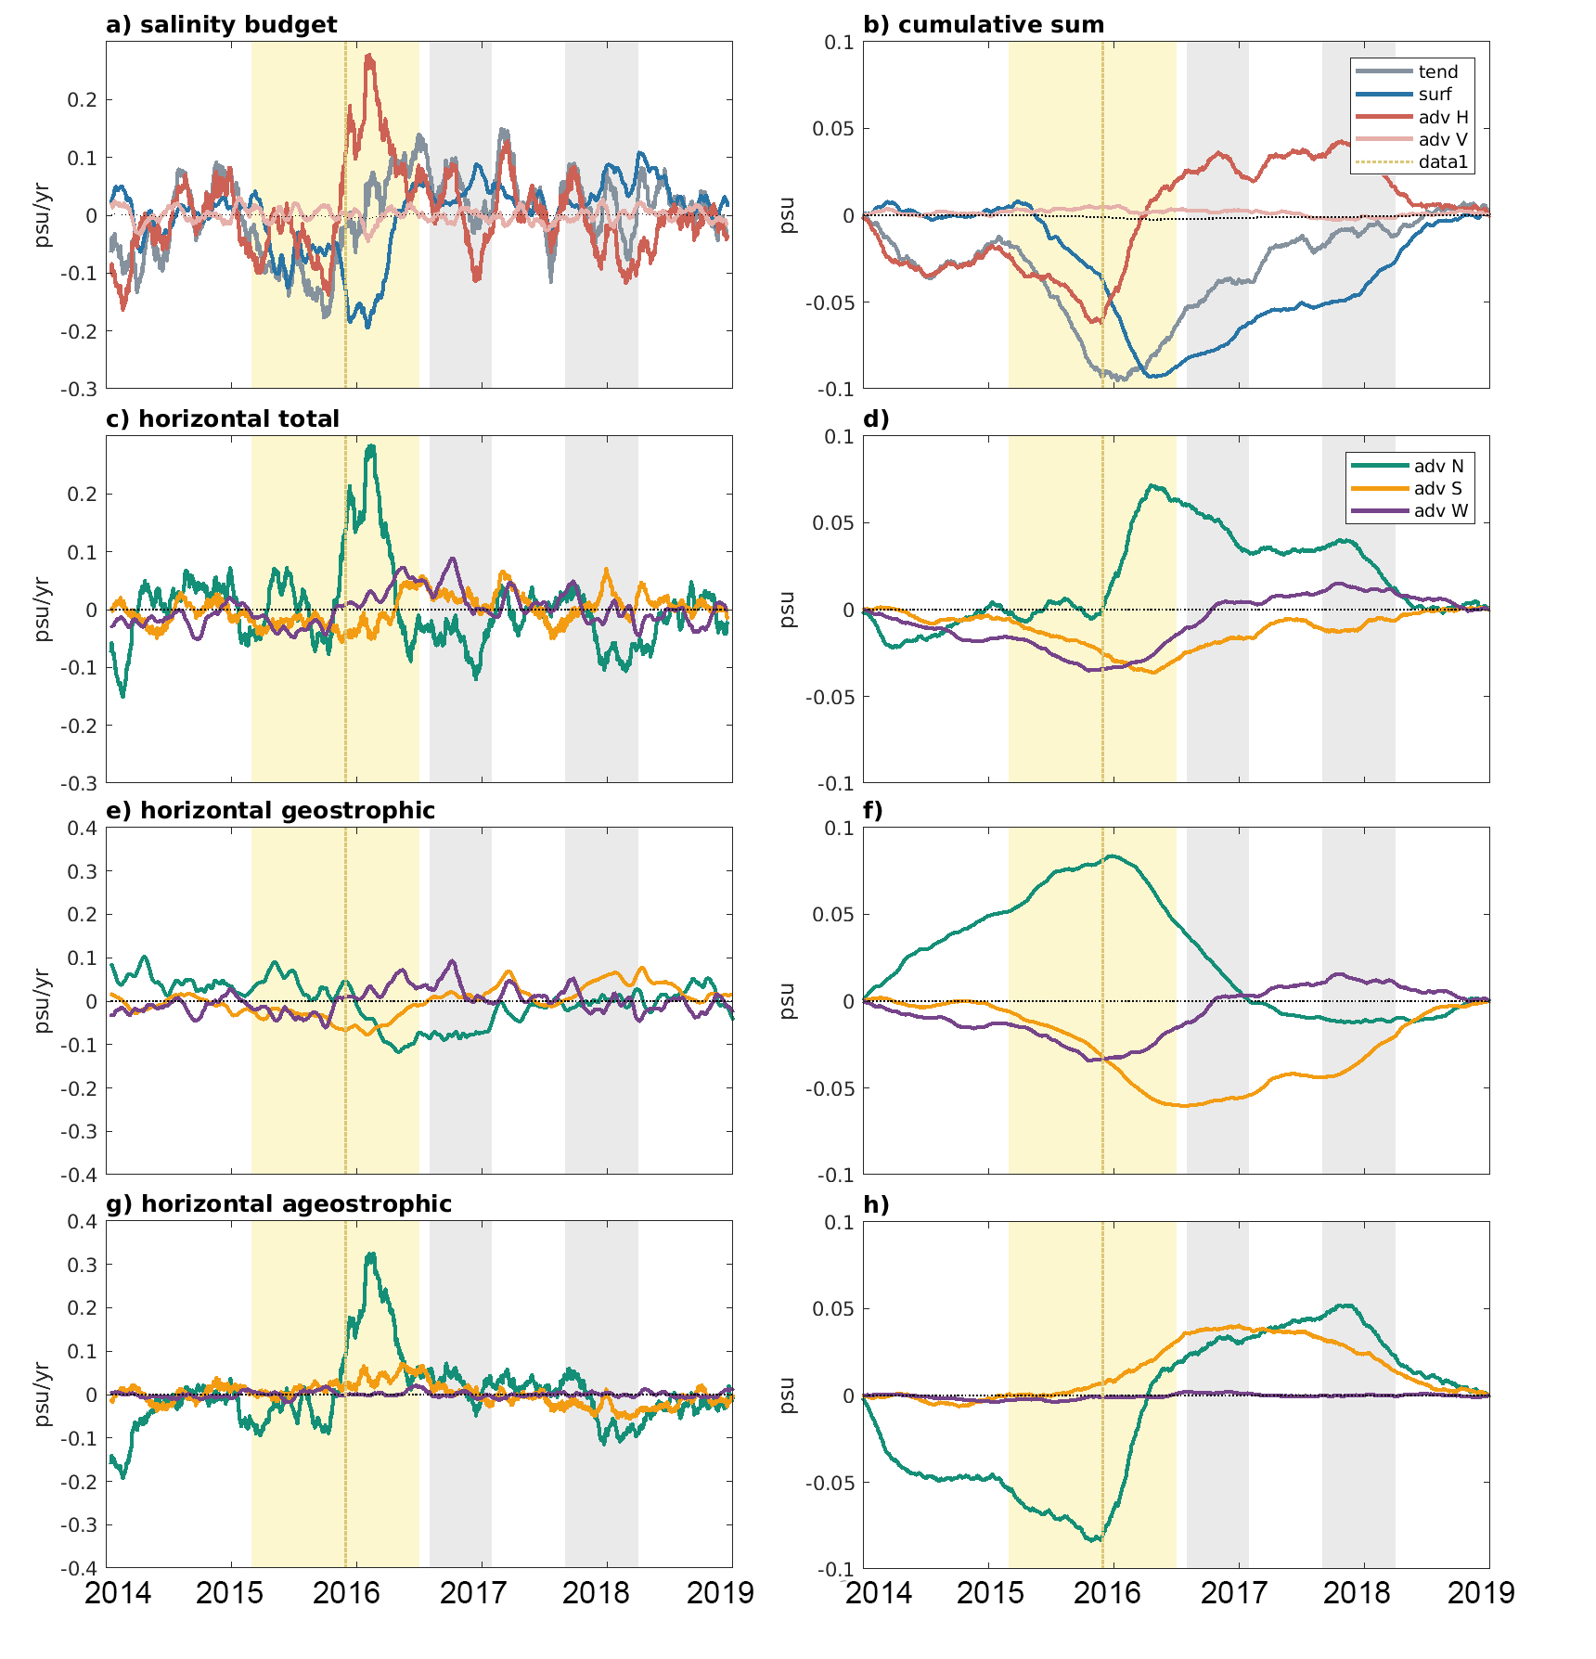
Salinity budget
Horizontal salt transport
Geostrophic
Ageostrophic

Slide 19
2014-2018 mean
surf
Ekman
geostrophic
up
North
East
ageo.
geostr.
Ekman
geostrophic
upwelling

Slide 20
2015/16 El Niño: onset
surf
weak zonal winds
Ekman
geostrophic
up
North
East
ageo.
geostr.
Ekman
geostrophic
upwelling

Slide 21
2015/16 El Niño: recovery
Ekman
geostrophic
warm, fresh surface water
up
North
FRESHWATER
East
HEAT
ageo.
geostr.
Ekman
geostrophic

Slide 22
Verdy et al. (2023) Balancing volume, temperature, and salinity budgets during 2014-2018 in the tropical Pacific Ocean state estimate. JGR-Oceans ecco.ucsd.edu/tpose.html
Ellen Davenport, Scripps PhD candidate
Poster tomorrow 3/13:
Understanding Tropical Mixing Processes and Their Parameterization Using an Ocean State Estimate

Slide 23
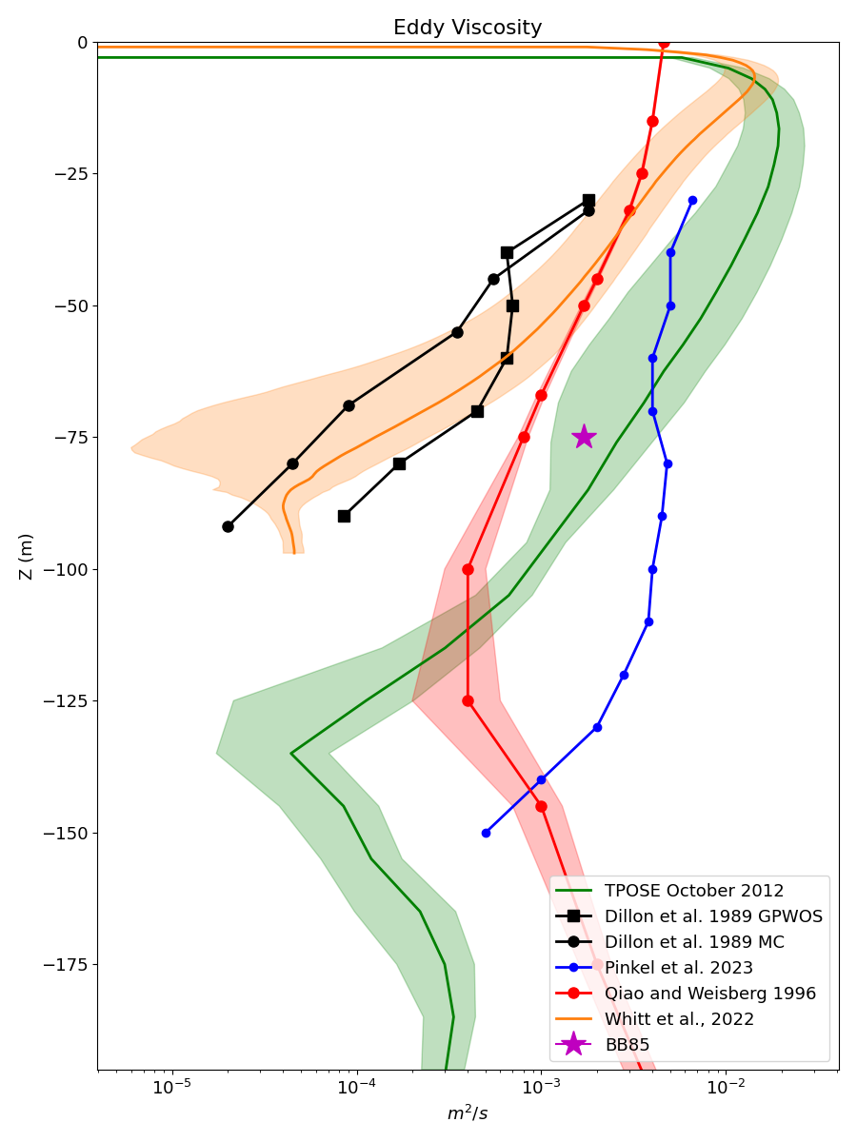
Momentum budget, 140ºW, 0ºN – Ellen Davenport
Vertical Flux of Zonal Momentum
Microstructure measurements
LES
Qiao & Weisberg ‘96
Bryden & Brady ‘85
Model KPP
Internal Waves
depth
Turbulent < Model KPP < Waves
m/s²

